Slide 1
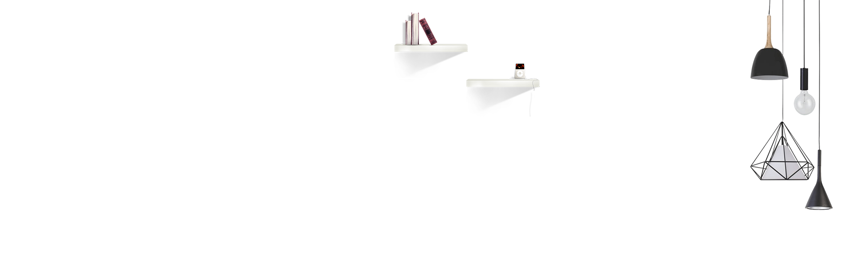


A Neural Image Caption Generator
Yuhan Li Jia Tan
Department of Computer Science
Illinois Institute of Technology

Slide 2
Part 01
Problem statement

Slide 3
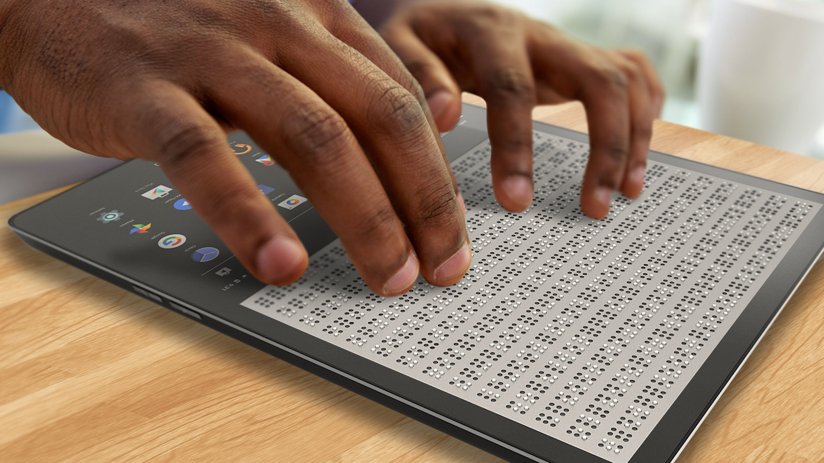

Problem statement
Helping visually impaired people to view pictures
Image search
Image Caption Generator
We need to let the computer understand the content of the image, and also need to express the meaning in human words, and the words must be concatenated in the correct way to be understood.

Slide 4
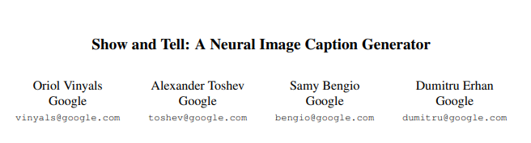
Problem statement
Main reference paper :

Slide 5
Part 02
Proposed solution

Slide 6
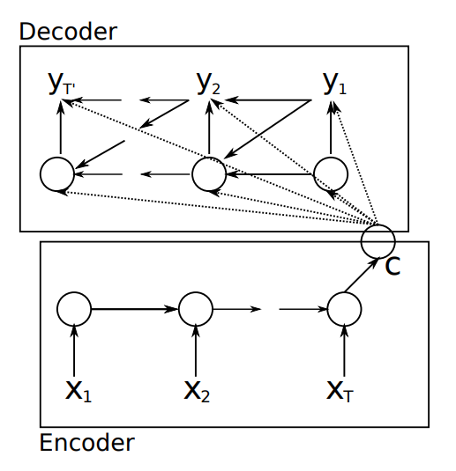
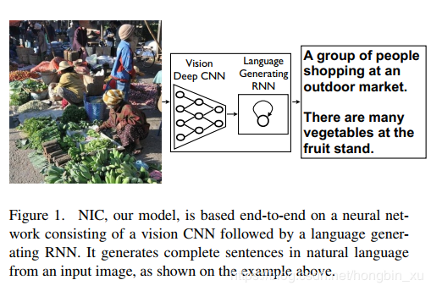
Proposed solution
machine translation
machine translation using RNN, where the task is to transform a sentence S written in a source language, into its translation T in the target language, by maximizing p(T|S). An “encoder” RNN reads the source sentence and transforms it into a rich fixed-length vector representation, which in turn in used as the initial hidden state of a “decoder” RNN that generates the target sentence.

Slide 7
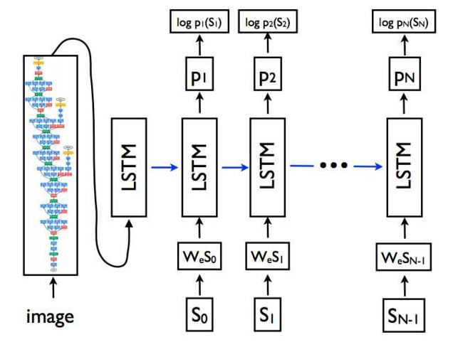
Proposed solution
CNNs can produce a rich representation of the input image by embedding it to a fixed-length vector. Hence, it is natural to use a CNN as an image“encoder”, by first pre-training it for an image classification task and using the last hidden layer as an input to the RNN decoder that generates sentences

Slide 8
Part 03
Implementation details

Slide 9
Implementation details
text process of description file
load_text
all_img_captions
cleaned_text
text_vacobulary
save_descriptions
1
2
3
4
5
load the description file in the dataset
mapping the image to the description into a dictionary
clean the text in lowercase, remove punctuation,remov ‘s and a, remove number
get all the vocabulary in descriptions, which used for count later.
save the descriptions in descriptions.txt

Slide 10
Implementation details
image extraction
InceptionV3 as CNN
Use InceptionV3 as pre-trained CNN model without the last classification layer to extract the image features.
2048 length vector
get the 2048 fixed-length vector as output
features.p
save the features into feature.p

Slide 11
Implementation details
clean training des
dict to list
clean the training descriptions, add “startseq” and “endseq”
change the training descriptions from dictionary to list
load training imgs
load feature
create tokenizer
load the file of names of training images
load training features
create tokenizer of the training descriptions’word

Slide 12
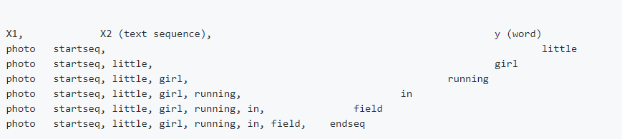
Implementation details
create sequences and data generator
sequnced words:a little girl running in field

Slide 13
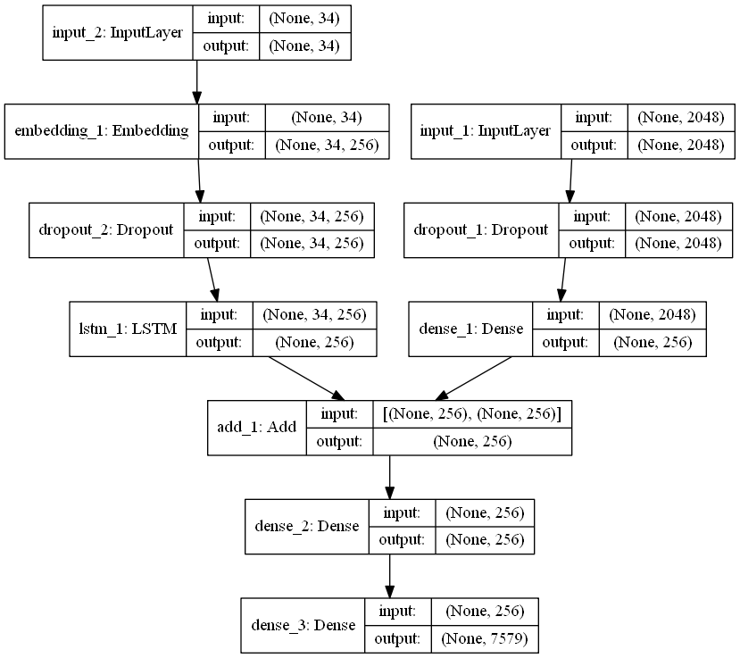
Implementation details
define model and training

Slide 14
Implementation details
prediction algorithm
BeamSearch
iteratively consider the set of the k best sentences up to time t as candidates to generate sentences of size t + 1, and keep only the resulting best k of them. This better approximates S = arg maxS0 p(S0|I)
sampling
sample the first word according to p1, then provide the corresponding embedding as input and sample p2, continuing like this until we sample the special end-of-sentence token or some maximum length

Slide 15
Part 04
Results and discussion

Slide 16
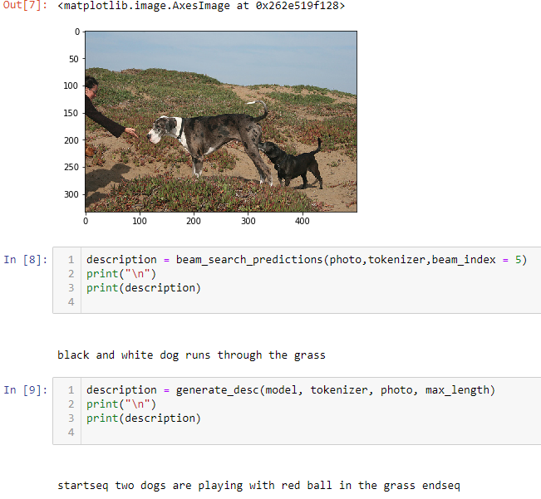
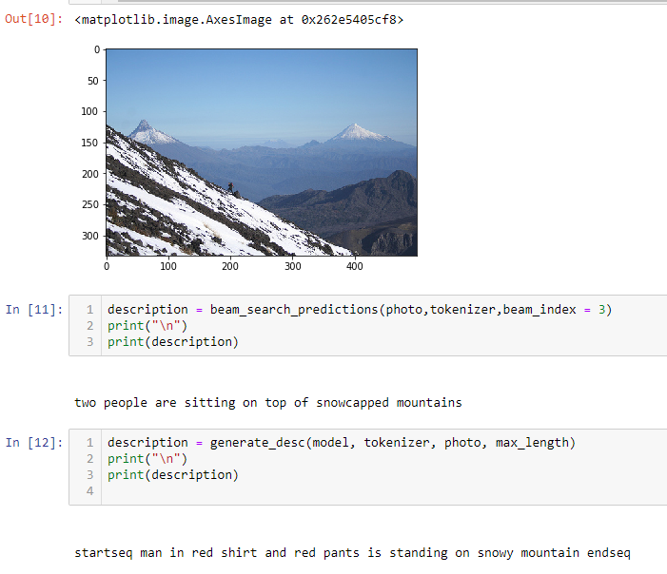
Results and discussion

Slide 17
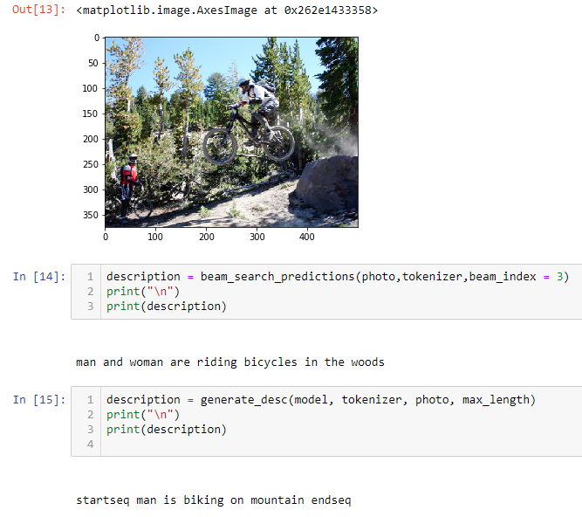
Results and discussion

Slide 18
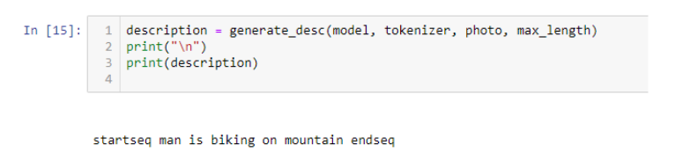
Results and discussion
Problem during the prediction
We first used “<start>” and “<end>” as our notation for starting and ending a description. And do the tokenizer for the notationed descriptions. But we didn’t pay attention to the Tokenizer function in Keras would ignore all the punctuations, so “<start>” becomes “start” and “<end>” becomes “end”.
That makes no difference between the notation and normal words and thus the model it trained is not right. Later we found the problem and decided to change the notation to “startseq” and “endseq” which is not a normal word but also without punctuations. And changed our codes to get an right model.

Slide 19
Results and discussion
Model improvement
Limitations:
It cannot predict words outside of the training_txt data. The occurrence of some items is too small, which leads to a decrease in the prediction accuracy of some infrequent objects. Some small movements cannot be distinguished, such as standing and running.
So for widely used we need larger dataset and different types of objects and movements to get a high-precision model.

Slide 20
THANK YOU

